Slide 1
Visualization of Internal Blockchain Processes
Shao-Chun Ma
July 18, 2018

Slide 2
Agenda
Introduction
Related Works
Methodology
Application
Scenarios
Summary

Slide 3
Motivation
In a proof-of-work blockchain network, miners compete with each other by adding blocks on the top of the longest blockchain
Network latency between nodes
Miners have different mining strategies
e.g., the minimum value of the mined transactions
Visualize the mining processes

Slide 4
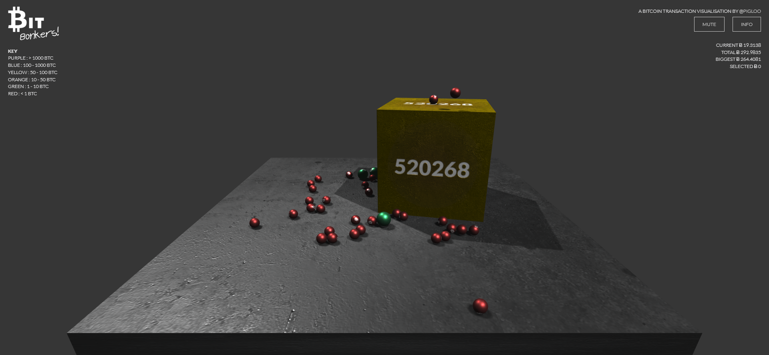
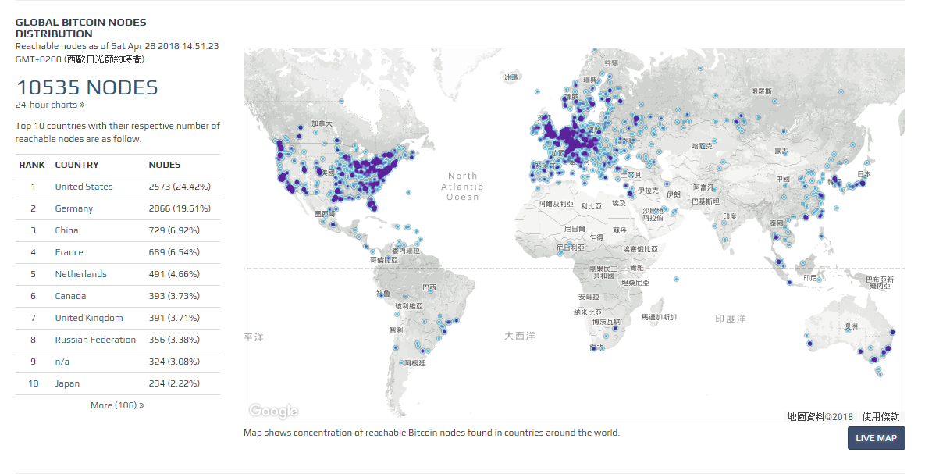
Blockchain Visualization
Cube: block
Balls: transactions
Blue dots: nodes
https://bitbonkers.com/
https://bitnodes.earn.com/

Slide 5
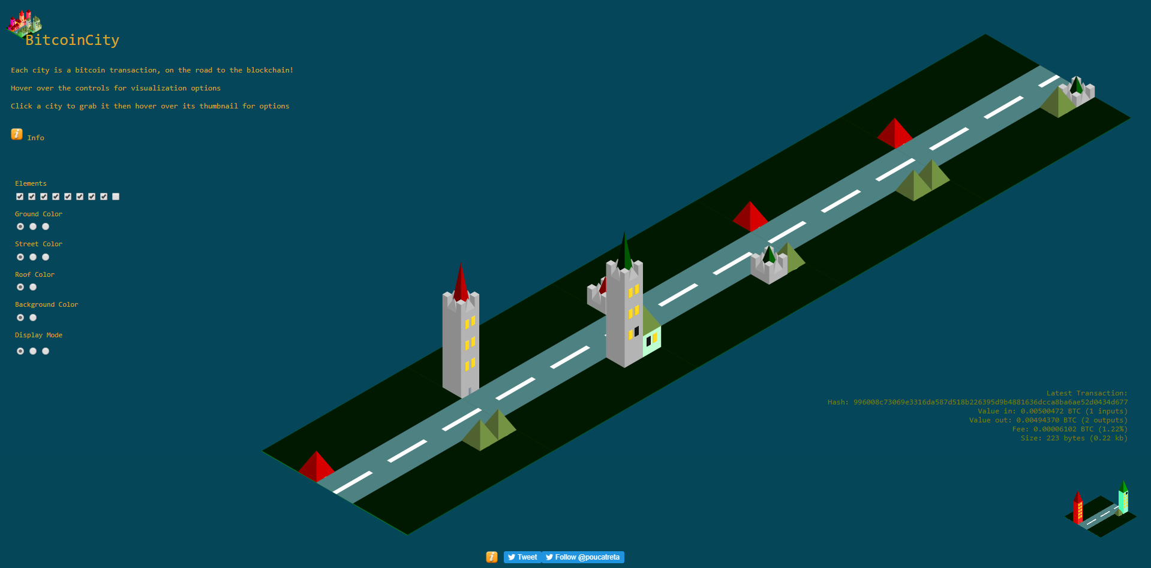
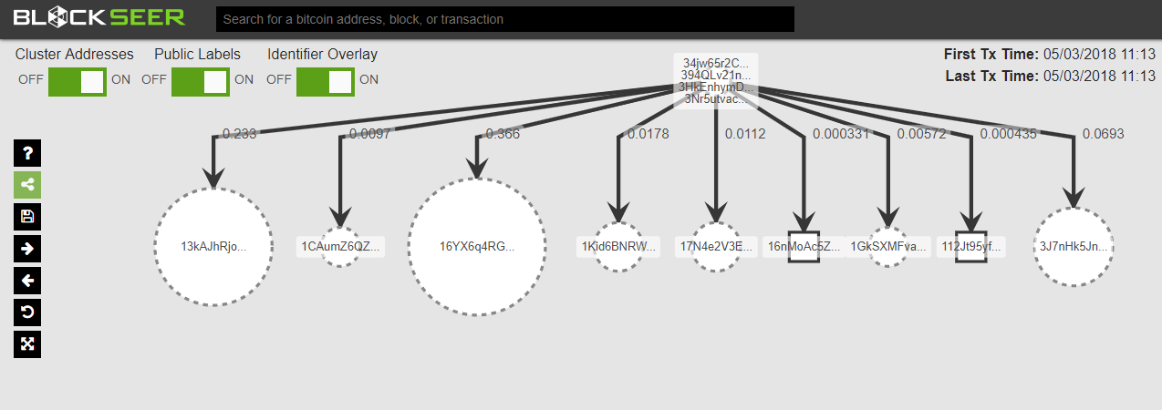
Blockchain Visualization
Buildings: blocks
Road: chain
Root: transaction
Leaves: outputs of transaction
http://bitcoincity.info/
https://www.blockseer.com/

Slide 6
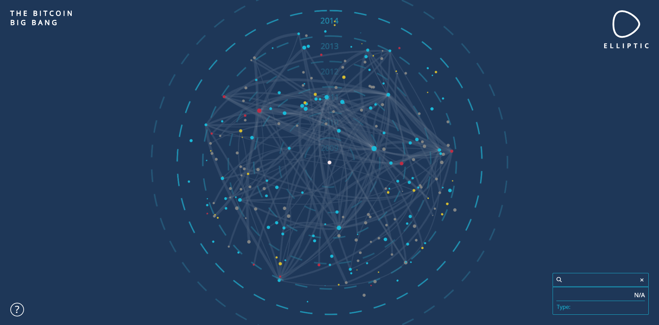
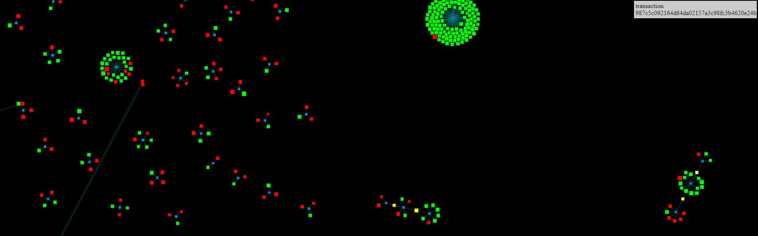
Blockchain Visualization
Cells: transactions
Green dots: outputs of transaction
Big Bang
Dots: blocks
https://dailyblockchain.github.io/
https://info.elliptic.co/hubfs/big-bang/bigbang-v1.html

Slide 7
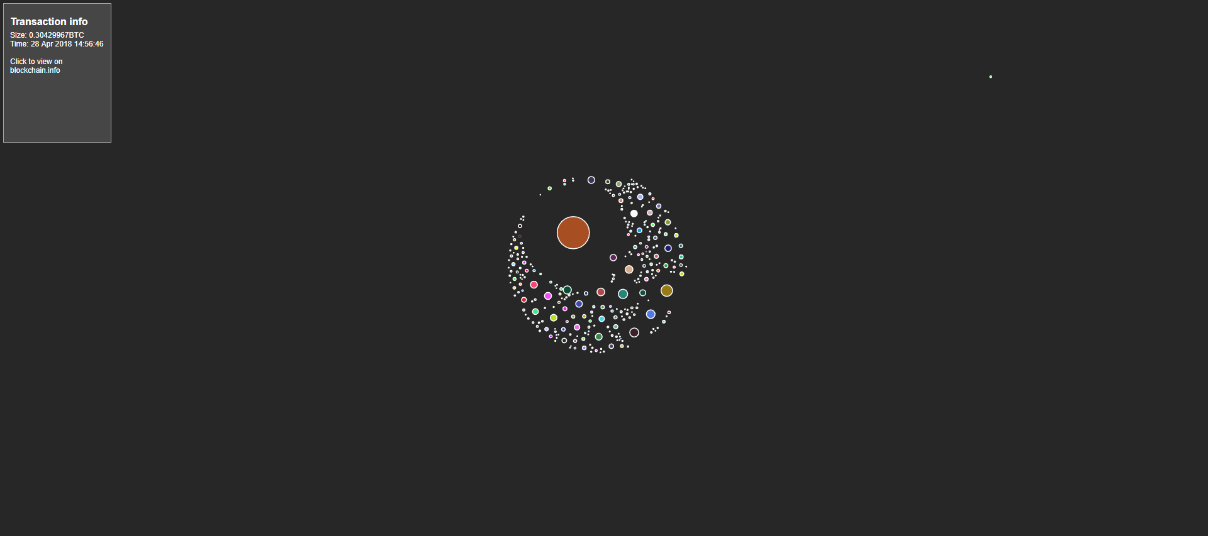
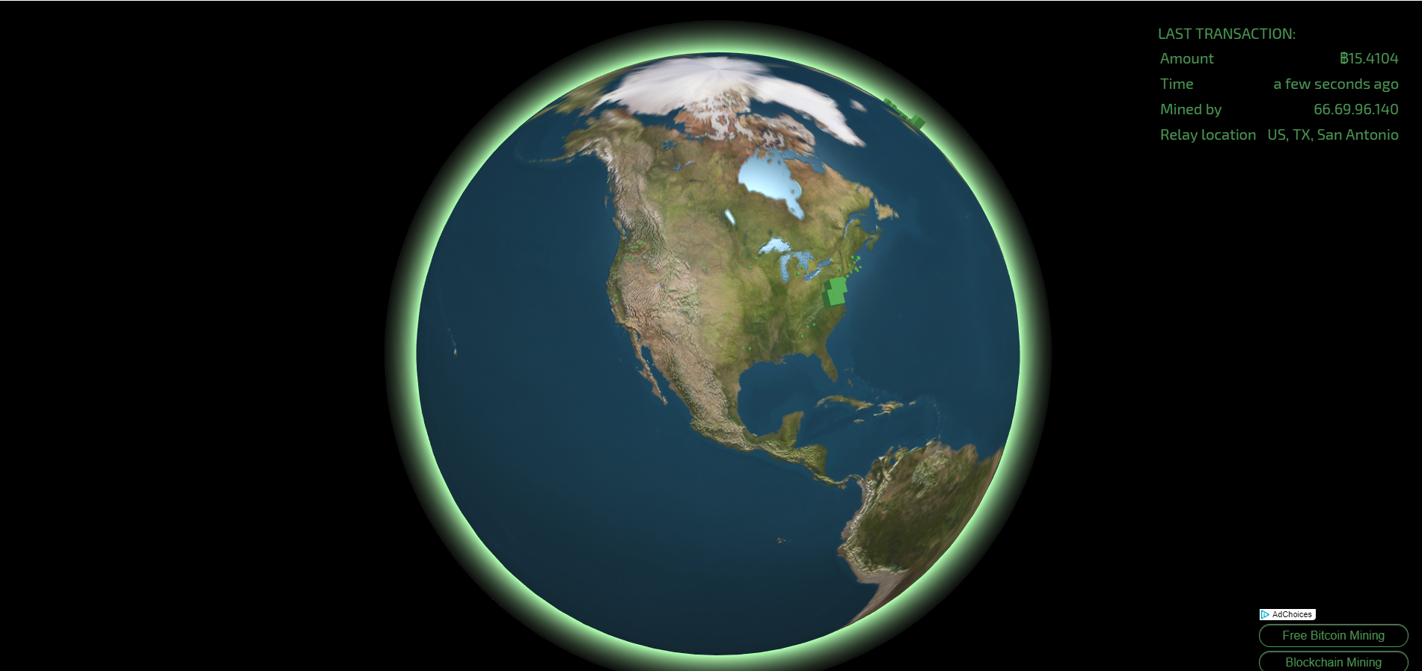
Blockchain Visualization
Circles: transactions
Green cubes: blocks
http://bitcoin.interaqt.nl/
https://blocks.wizb.it/

Slide 8
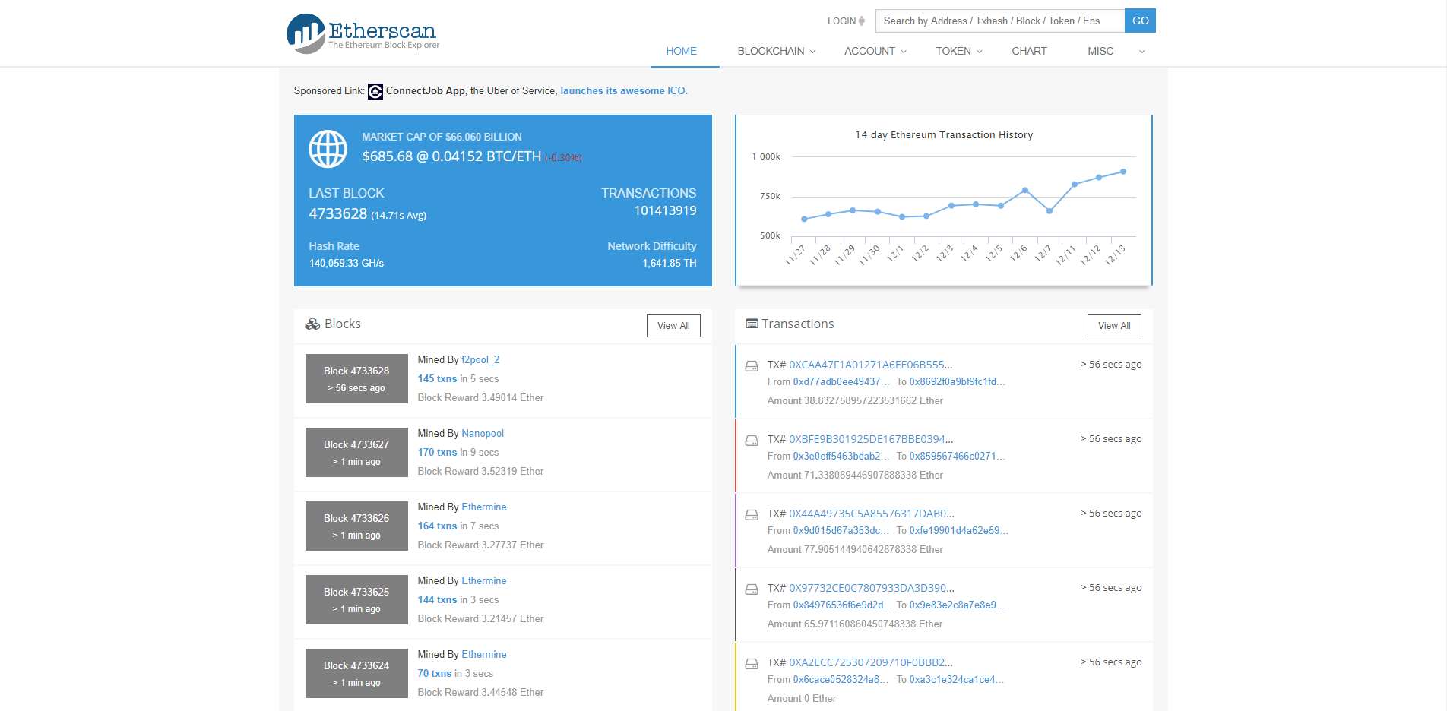
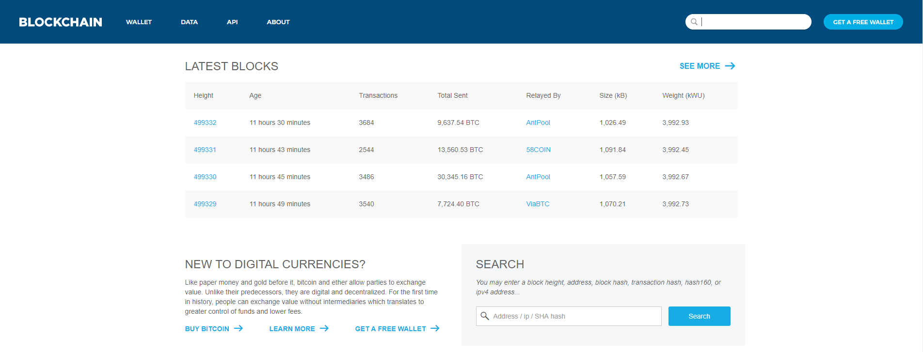
Blockchain Visualization
Tableau method
https://blockchain.info/
https://etherscan.io/

Slide 9
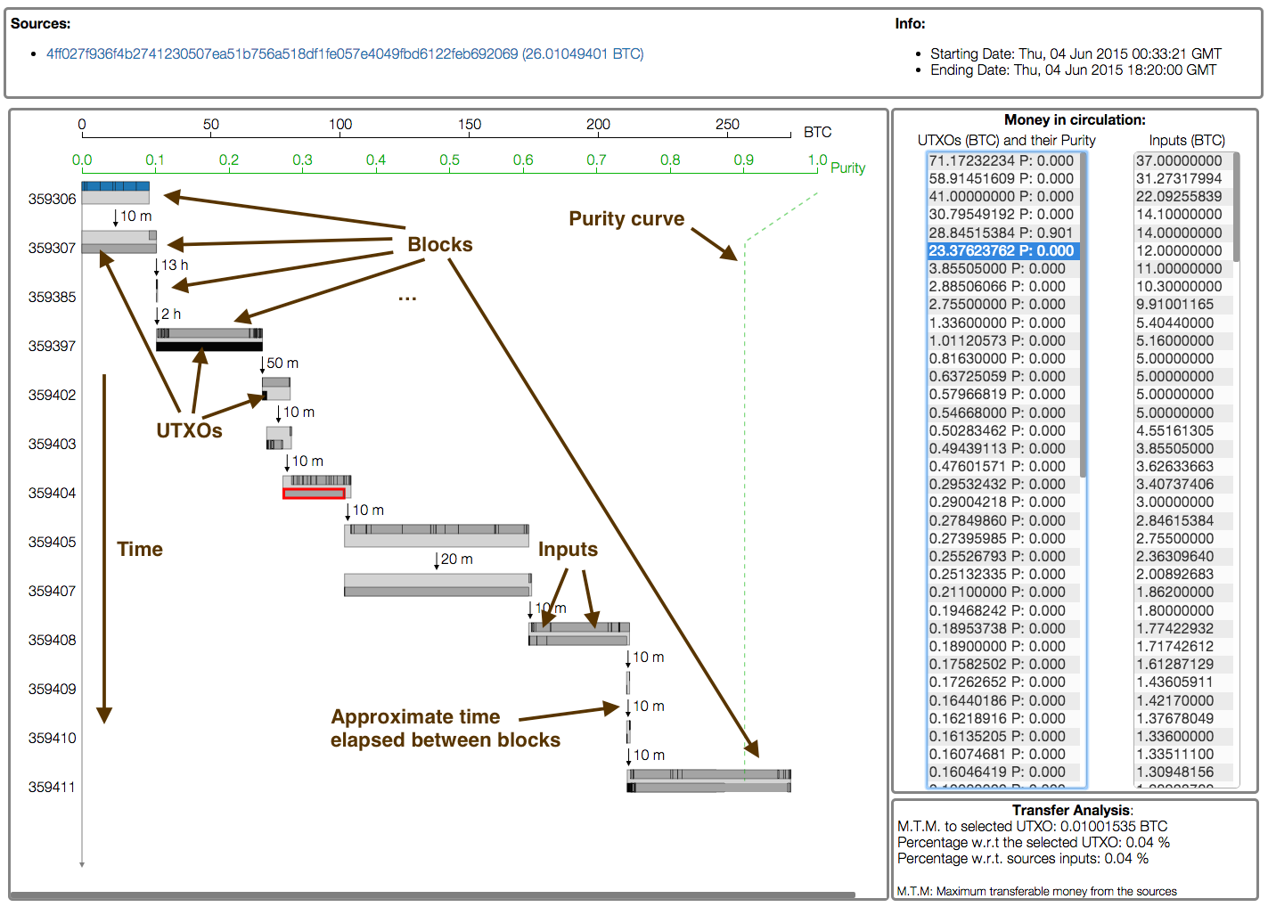
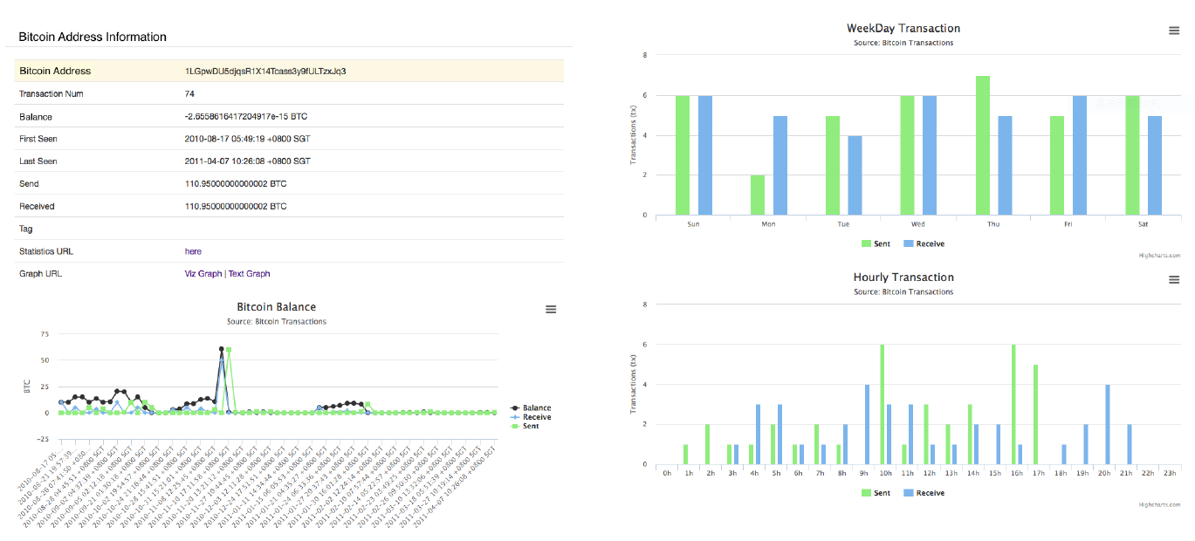
Blockchain Visualization
Analysis method
Battista 2015
Kuzuno 2017

Slide 10
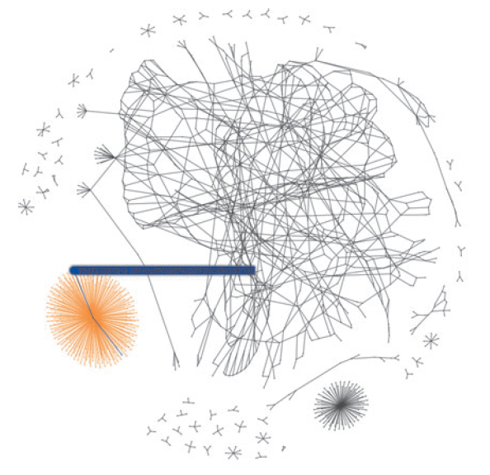
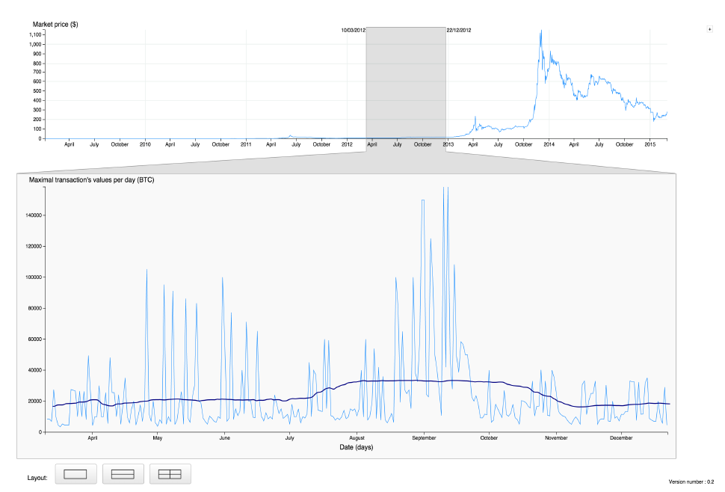
Blockchain Visualization
Analysis method
McGinn 2016
Saublet 2015

Slide 11
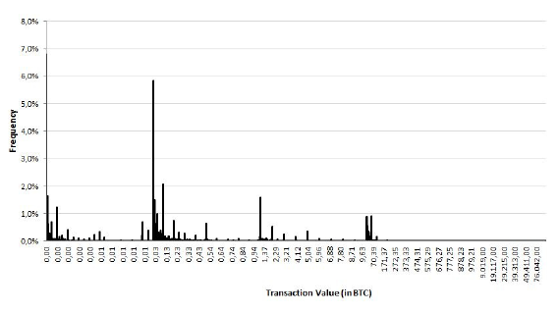
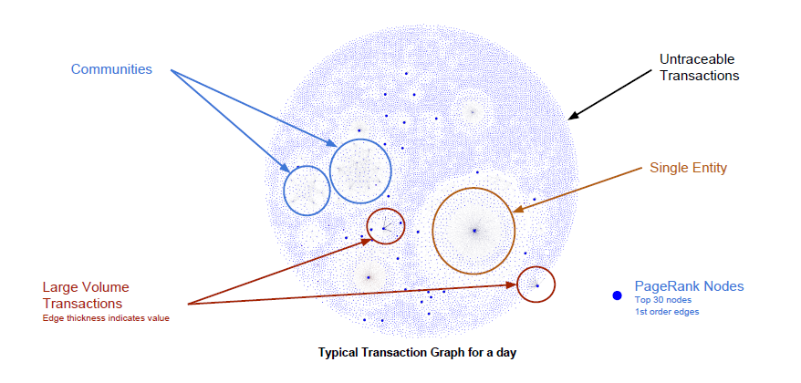
Blockchain Visualization
Analysis method
Fleder 2015
Baumann 2014

Slide 12
Related Works
Problems:
No forks
Static information
Cannot identify the influence of different mining strategies and network latency

Slide 13
Overview
Nodes: a transaction generator, miners, nonminers
Network latency
Miners have different mining strategies
An application which can display the mining activities step by step
Upload a predefined file to replay the same mining processes

Slide 14
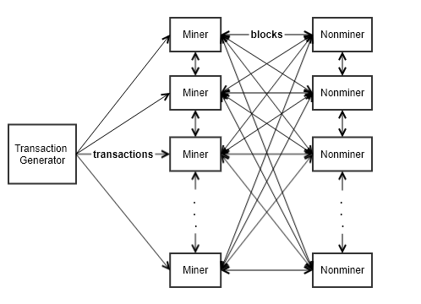
Factors
Network Latency
Mining Strategy
Transaction generator ⇒ Miners
Miners ⇔ Nonminers
Minimum value of transactions
Number of mined transactions in a block

Slide 15
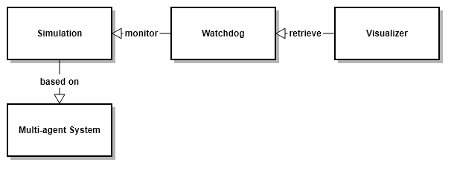
Application Architecture
Blockchain simulation: based on the multi-agent system
Watchdog: monitoring the blockchain system
Visualizer: visualizing the mining processes

Slide 16
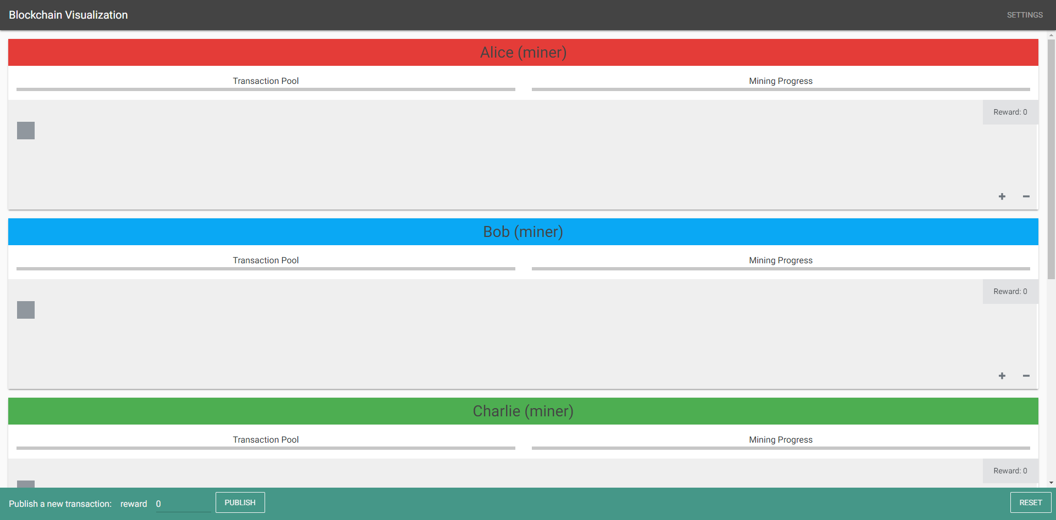
Visualization
Beginning

Slide 17
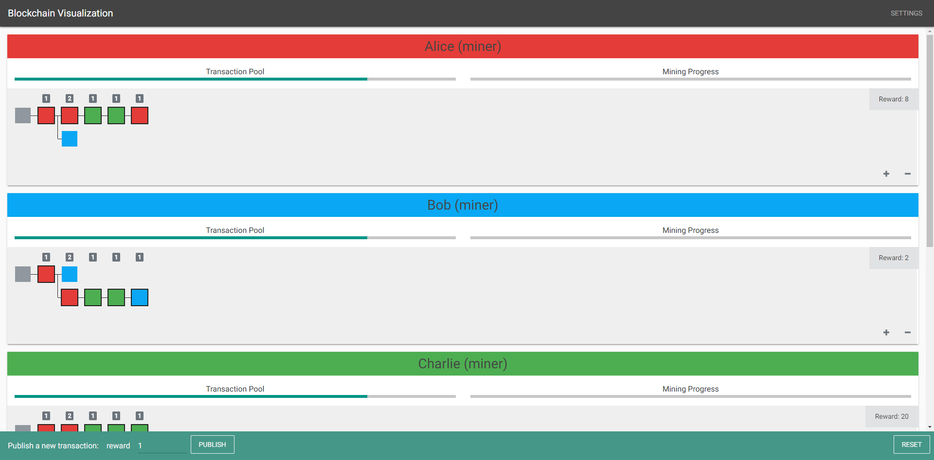
Visualization
After mining

Slide 18
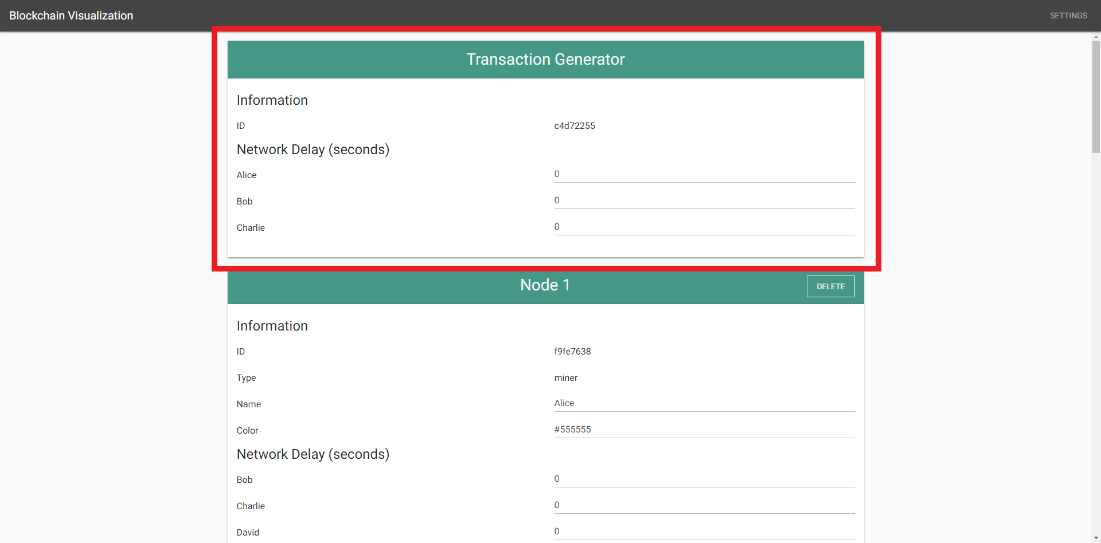
Settings (Transaction Generator)
ID
Network Delay

Slide 19
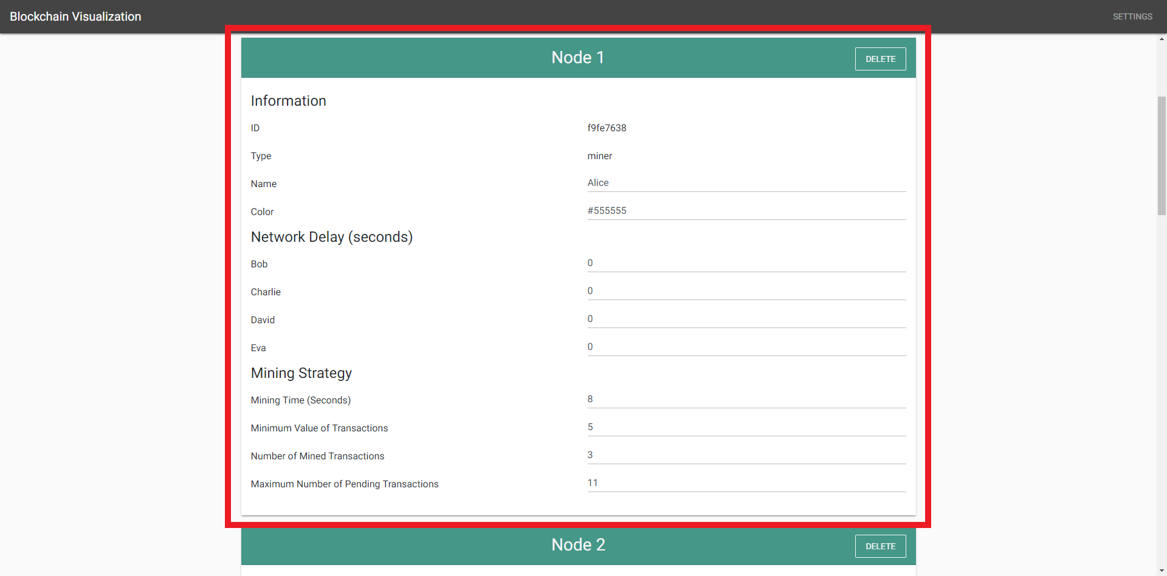
Settings (Miner)
ID
Name
Color
Network Delay
Mining Strategy

Slide 20
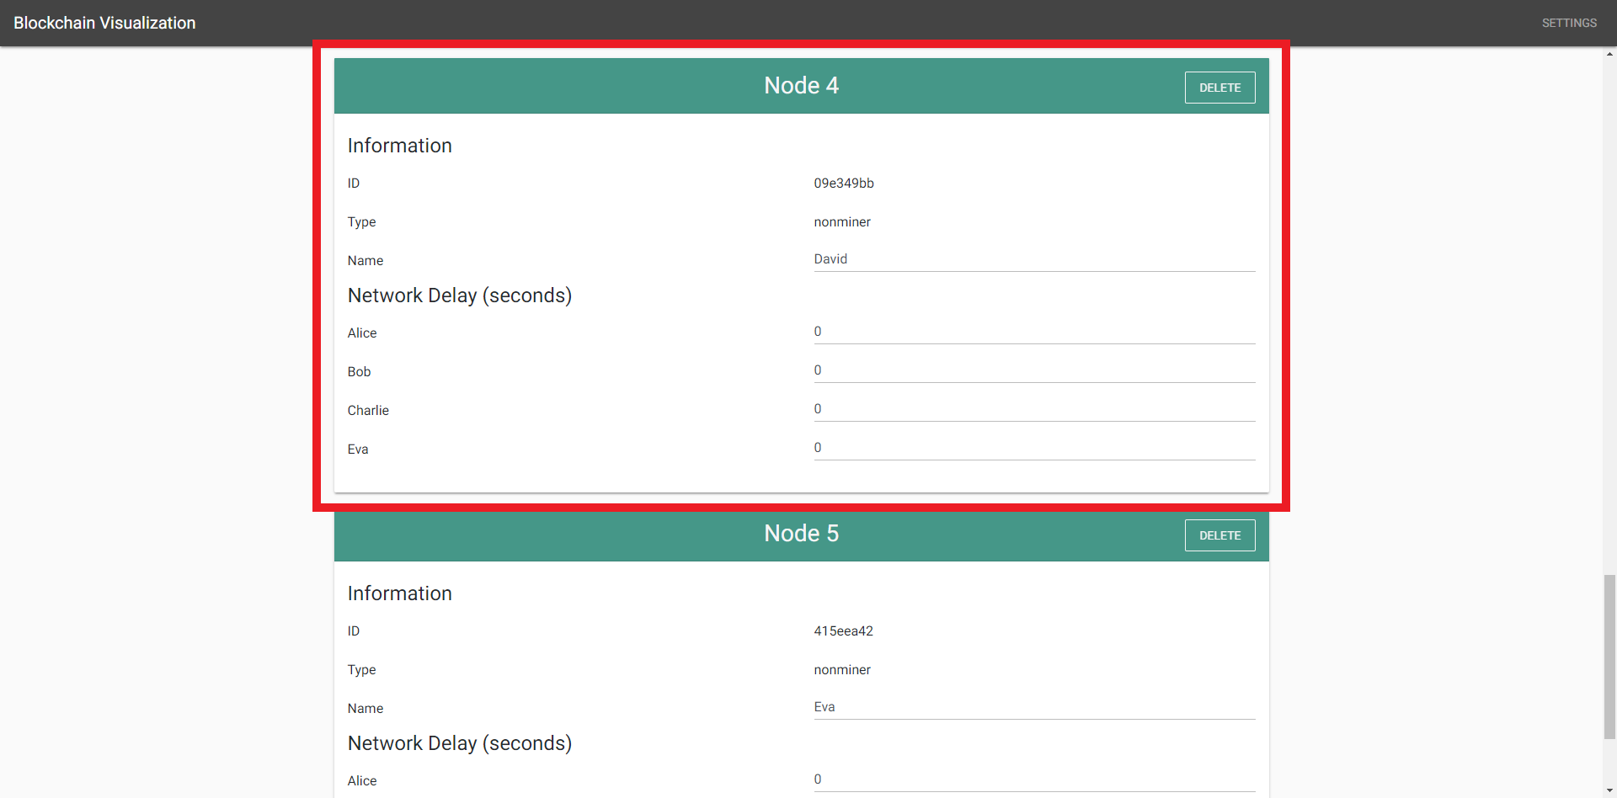
Settings (Nonminer)
ID
Name
Network Delay

Slide 21
Influence of Mining Strategy
Three miners: Alice, Bob, Charlie
Alice mines very fast because Alice’s minimum value of transactions and number of mined transactions are set to the lowest comparing to Bob’s and Charlie’s
The network latency is low, so the publish of blocks is fast
The computing powers are the same
As a result, Alice added blocks to the blockchain faster than Bob and Charlie did

Slide 22
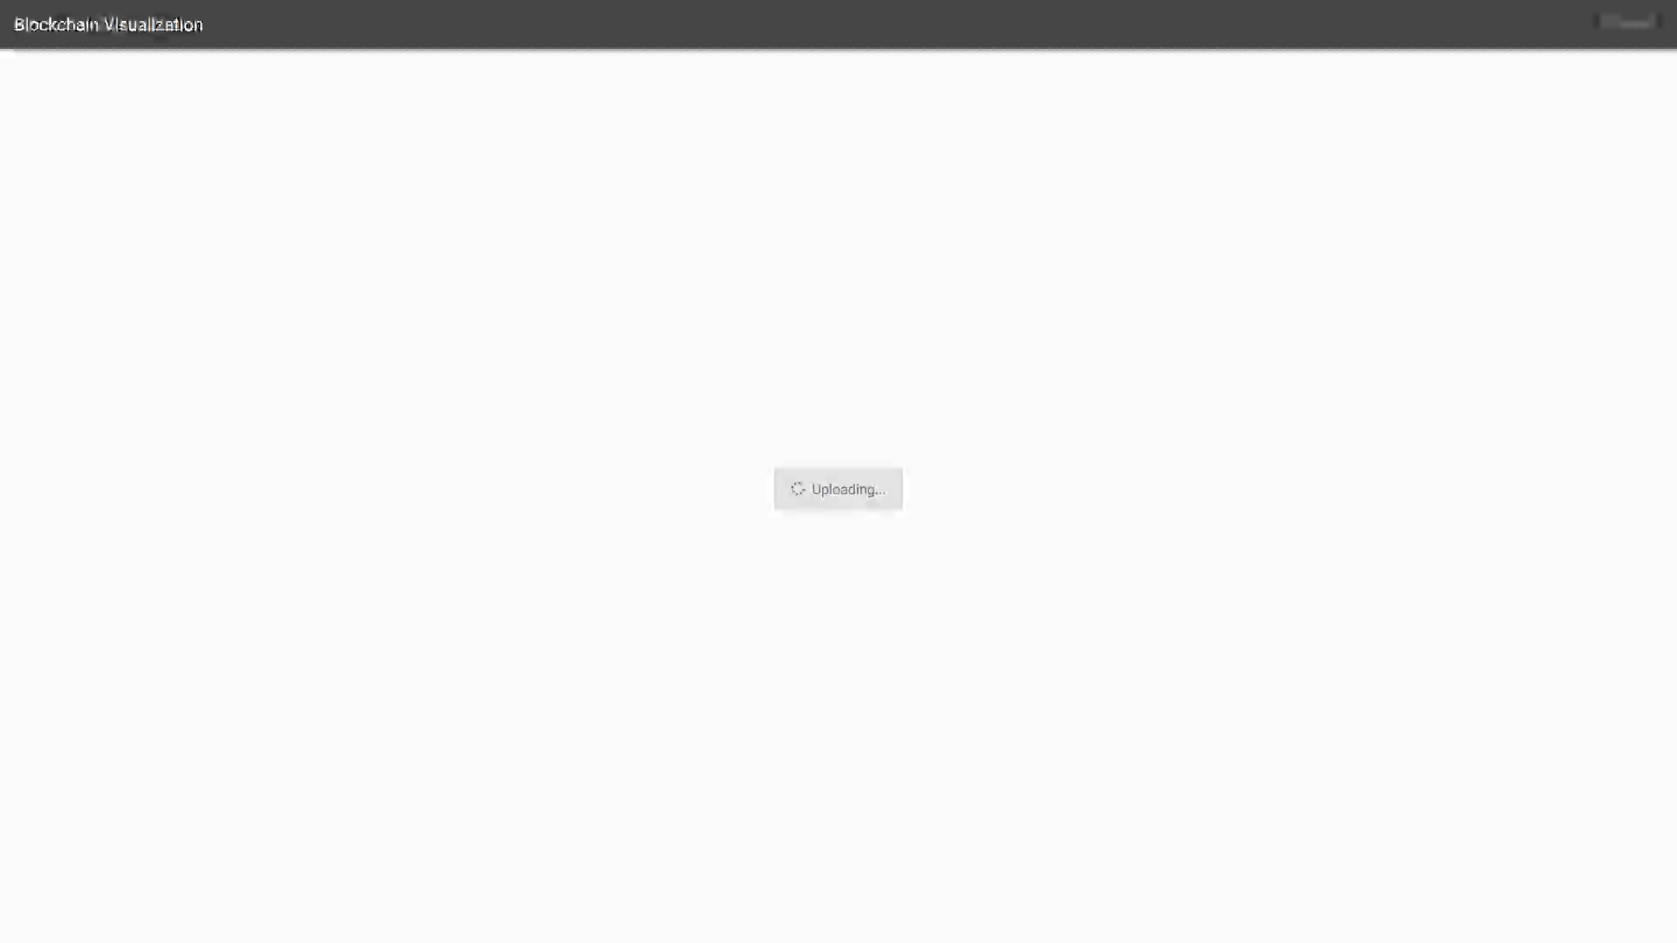
Influence of Mining Strategy

Slide 23
Influence of Network Latency
Three miners: Alice, Bob, Charlie
The network latency is very high
The mining time is shorter than the network latency
The mining strategies are the same
As a result, the three miners are divided into three groups which work on their own longest blockchain

Slide 24
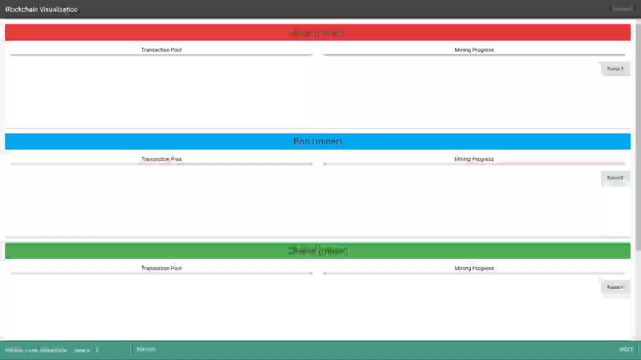
Influence of Network Latency

Slide 25
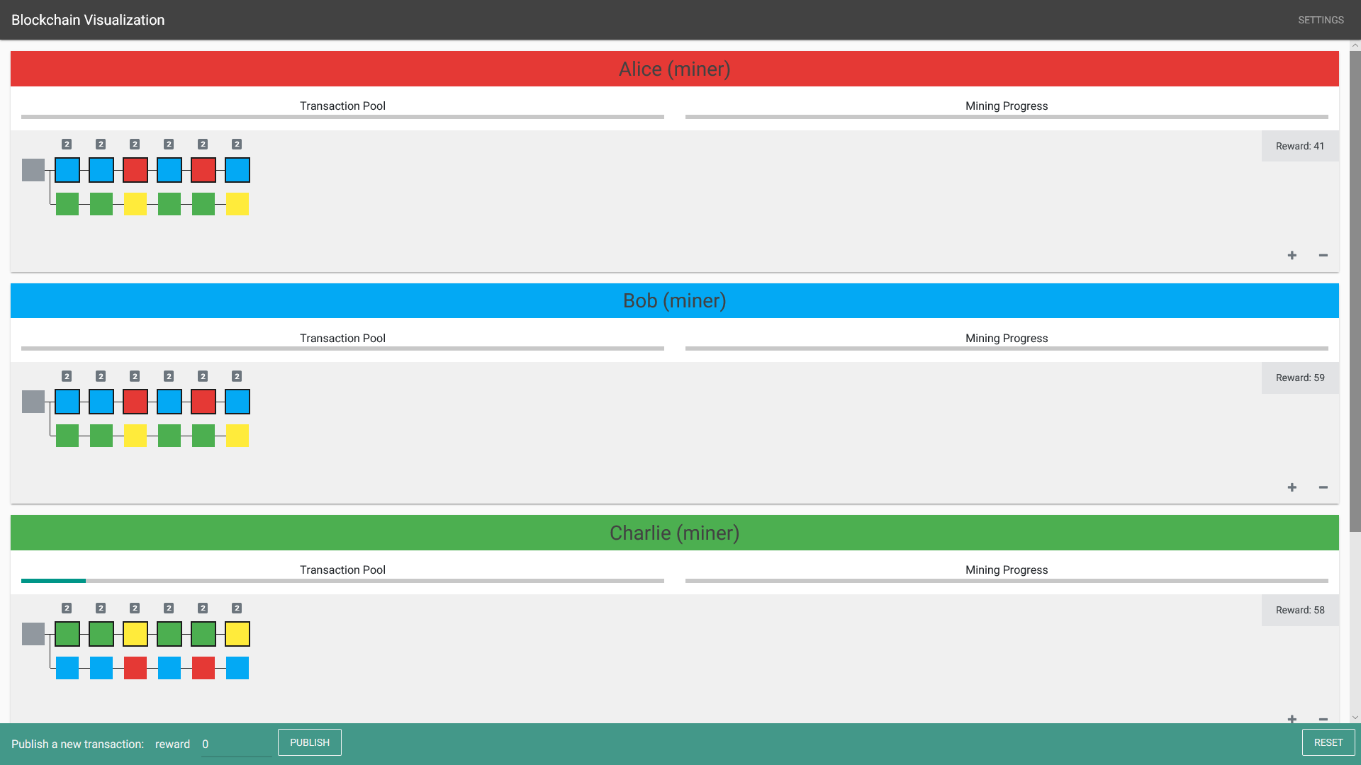
Influence of Network Latency
Problem: The forks cannot be merged afterward
Reason: The parameters are fixed during the process

Slide 26
Summary
The mining processes are influenced by mining strategies and network latency
Real-time visualization which displays the mining processes step by step for each node
Future work
Add different consensus protocols (e.g., proof-of-stake)
Add malicious nodes
Dynamic nodes: jump in and out at any time

